Slide 1
C Programming
Prepared By Sumon Karmakar

Slide 2
C Programming
C Programming Language helps us to understand programming language easily.
It was developed by Dennis Ritchie in 1972 at bell laboratories of AT&T, located in USA

Slide 3
C Programming
Basic Syntax of C Language:-
#include<stdio.h>
void main()
{
printf(“Hello World”);
}
Output:- Hello World

Slide 4
C Programming
Features of C Language:- C is widely known language. It has the following features
Simple
Machine independent or Portable
Mid-level programming language
Structured Programming language
Rich Library
Memory Management
Fast Speed
Pointer
Recursion
Extensible

Slide 5
C Programming
First C Program:-
#include<stdio.h>
void main()
{
printf(“Hello World”);
}
Output:- Hello World

Slide 6
C Programming
How to Compile and Run The Program:-
1. By Menu
2. By ShortCut

Slide 7
C Programming
Execution Flow of the C Program:- 1) C program (source code) is sent to preprocessor first. The preprocessor is responsible to convert preprocessor directives into their respective values. The preprocessor generates an expanded source code.
2) Expanded source code is sent to compiler which compiles the code and converts it into assembly code.
3) The assembly code is sent to assembler which assembles the code and converts it into object code. Now a simple.obj file is generated.
4) The object code is sent to linker which links it to the library such as header files. Then it is converted into executable code. A simple.exe file is generated.
5) The executable code is sent to loader which loads it into memory and then it is executed. After execution, output is sent to console.

Slide 8
C Programming
Execution Flow of the
C Program:-

Slide 9
C Programming
printf() and scanf() function:-
printf() function:- The printf() function is used for output. It prints the given statement to the console.
The syntax of printf() function is given below:
printf("format string",argument_list);
The format string can be %d (integer), %c (character), %s (string), %f (float) etc.

Slide 10
C Programming
printf() and scanf() function:-
scanf() function:- The scanf() function is used for input. It reads the input data from the console.
scanf("format string",argument_list);

Slide 11
C Programming
Example of printf() and scanf() function:-
#include<stdio.h>
int main(){
int number;
printf("enter a number:");
scanf("%d",&number);
printf("cube of number is:%d ",number*number*number);
return 0;
}
O/p:- Enter a number: 5
Cube of 5 is 125

Slide 12
C Programming
Example of printf() and scanf() function :-
#include<stdio.h>
int main(){
int x=0,y=0,result=0;
printf("enter first number:");
scanf("%d",&x);
printf("enter second number:");
scanf("%d",&y);
result=x+y;
printf("sum of 2 numbers:%d ",result);
return 0;
}
O/p:- Enter a number: 5
Cube of 5 is 125

Slide 13
C Programming
Variables in C:- A variable is a name of memory location. It is used to store data. Its value can be changed and it can be reused many times.
It is a way to represent memory location through symbol so that it can be easily identified.
Syntax:- type variable_list;
E.g:- int a, float b, char c

Slide 14
C Programming
Rules for defining Variables in C:- A variable can have alphabets, digits and underscore.
A variable name can start with alphabet and underscore only. It can't start with digit.
No white space is allowed within variable name.
A variable name must not be any reserved word or keyword e.g. int, float etc.

Slide 15
C Programming
Rules for defining Variables in C:-
Valid Variable names:- int a;
int _ab;
int a30;
Invalid Variable names:- int 2;
int a b;
int long;

Slide 16
C Programming
Types of Variables in C:- There are many types of variables in c:
local variable
global variable
static variable
automatic variable
external variable

Slide 17
C Programming
Types of Variables in C:-
local variable:- A variable that is declared inside the function or block is called local variable.
It must be declared at the start of the block.
void function1(){
int x=10;//local variable
}

Slide 18
C Programming
Types of Variables in C:-
global variable:- A variable that is declared outside the function or block is called global variable. Any function can change the value of the global variable. It is available to all the functions.
It must be declared at the start of the block.
int value=20;//global variable
void function1(){
int x=10;//local variable
}

Slide 19
C Programming
Types of Variables in C:-
static variable:- A variable that is declared with static keyword is called static variable.
It retains its value between multiple function calls.
void function1(){
int x=10;//local variable
static int y=10;//static variable
x=x+1;
y=y+1;
printf("%d,%d",x,y); }
If you call this function many times, local variable will print the same value for each function call e.g, 11,11,11 and so on. But static variable will print the incremented value in each function call e.g. 11, 12, 13 and so on.

Slide 20
C Programming
Types of Variables in C:-
automatic variable:- All variables in C that is declared inside the block, are automatic variables by default. By we can explicitly declare automatic variable using auto keyword.
void main(){
int x=10;//local variable (also automatic)
auto int y=20;//automatic variable
}

Slide 21
C Programming
Types of Variables in C:-
external variable:- We can share a variable in multiple C source files by using external variable. To declare a external variable, you need to use extern keyword.
myfile.h
extern int x=10;//external variable (also global)
program1.c
#include "myfile.h"
#include <stdio.h>
void printValue(){
printf("Global variable: %d", global_variable);
}

Slide 22
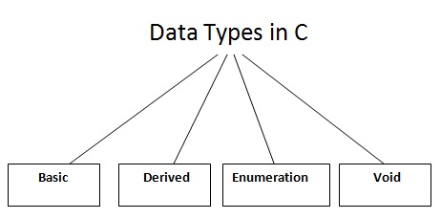
C Programming
Data Types in C:- A data type specifies the type of data that a variable can store such as integer, floating, character etc.

Slide 23
C Programming
Data Types in C:- There are 4 data types in C language.
Types | Data Types
Basic Data Type | int, char, float, double
Derived Data Type | array, pointer, structure, union
Enumeration Data Type | enum
Void Data Type | void

Slide 24
C Programming
Keywords in C:- A keyword is a reserved word. You cannot use it as a variable name, constant name etc. There are only 32 reserved words (keywords) in C language.
There are 32 keywords in C. They are
auto | break | case | char | const | continue | default | do
double | else | enum | extern | float | for | goto | if
int | long | register | return | short | signed | sizeof | static
struct | switch | typedef | union | unsigned | void | volatile | while

Slide 25
C Programming
Operators in C:- An operator is simply a symbol that is used to perform operations. There can be many types of operations like arithmetic, logical, bitwise etc.
There are following types of operators to perform different types of operations in C language.
Arithmetic Operators
Relational Operators
Shift Operators
Logical Operators
Bitwise Operators
Ternary or Conditional Operators
Assignment Operator

Slide 26
C Programming
Comments in C:- Comments in C language are used to provide information about lines of code. It is widely used for documenting code. There are 2 types of comments in C language.
Single Line Comments
Multi Line Comments

Slide 27
C Programming
Comments in C:-
Single Line Comments:- Single line comment is represented by double slash(\\).
#include<stdio.h>
int main(){
// printing information
printf(“Hello World.”);
}

Slide 28
C Programming
Comments in C:-
Multiline Line Comments:- Multi line comments are represented by slash asterisk \* ... *\. It can occupy many lines of code but it can't be nested. Syntax:
/*
code
to be commented
*/

Slide 29
C Programming
Comments in C:-
Multiline Line Comments:-
#include<stdio.h>
void main(){ /*printing information
Multi Line Comment*/
printf("Hello C");
return 0;
}
Output:- Hello C

Slide 30
C Programming
Escape Sequence in C:- An escape sequence in C language is a sequence of characters that doesn't represent itself when used inside string literal or character.
\n | New Line
\r | Carriage Return
\t | Tab (Horizontal)
\v | Vertical Tab

Slide 31
C Programming
Constant in C:- A constant is a value or variable that can't be changed in the program, for example: 10, 20, 'a', 3.4, "c programming" etc.

Slide 32
C Programming
Defining Constant in C:- There are two ways for defining constant in C
1. const keyword
2. #define preprocessor

Slide 33
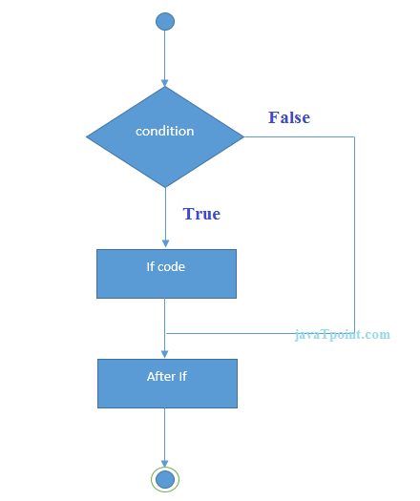
C Programming
C If Statement:- The single if statement in C language is used to execute the code if condition is true. The syntax of if statement is given below:
if(expression){
//code to be executed
}

Slide 34
C Programming
C If Statement Program:-#include<stdio.h>
int main(){
int number=0;
printf("enter a number:");
scanf("%d",&number);
if(number%2==0){
printf("%d is even number",number);
} return 0;
}
O/p:- Enter a number: 5
5 is odd number

Slide 35
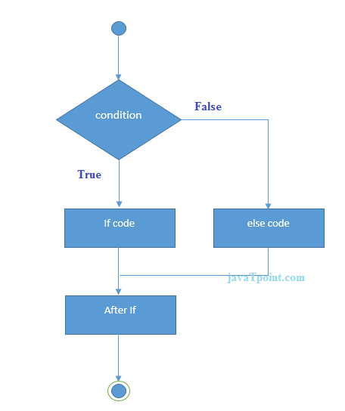
C Programming
C If-else Statement Program:-The if-else statement in C language is used to execute the code if condition is true or false. The syntax of if-else statement is given below:
if(expression){
//code to be executed if condition is true
}else{
//code to be executed if condition is false
}

Slide 36
C Programming
C If-else Statement Program:-#include<stdio.h>
int main(){
int number=0;
printf("enter a number:");
scanf("%d",&number);
if(number%2==0){
printf("%d is even number",number); }
else{ printf("%d is odd number",number); }
return 0; }
O/p:- Enter a number: 4
4 is even Number
Enter a number:5
5 is odd number

Slide 37
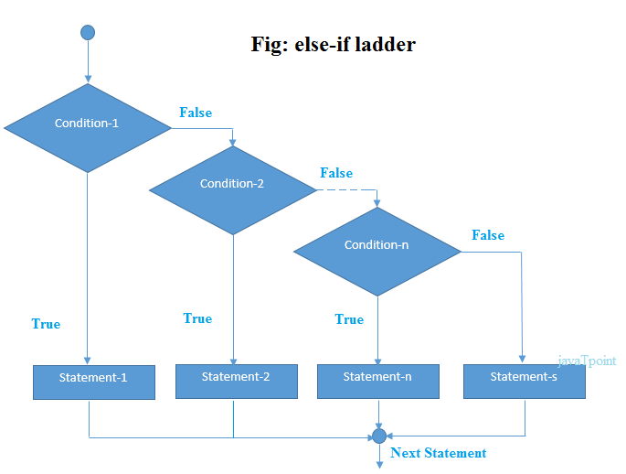
C Programming
C If-else-if ladder Statement:- The if else-if statement is used to execute one code from multiple conditions. The syntax of if else-if statement is given below:
if(condition1){
//code to be executed if condition1 is true
}else if(condition2){
//code to be executed if condition2 is true
}
else if(condition3){
//code to be executed if condition3 is true
}
...
else{
//code to be executed if all the conditions are false
}

Slide 38
C Programming
C If-else-if Statement Program:- #include<stdio.h>
int main(){
int number=0;
printf("enter a number:");
scanf("%d",&number);
if(number==10){ printf("number is equals to 10"); }
else if(number==50){ printf("number is equal to 50"); }
else if(number==100){ printf("number is equal to 100"); }
else{ printf("number is not equal to 10, 50 or 100"); }
return 0;
}
O/p:- Enter a number:4
Number is not equal to 10,50 or 100
Enter a number: 50
Number is Equal to 50

Slide 39
C Programming
C Switch Statement:-The switch statement in C language is used to execute the code from multiple conditions. It is like if else-if ladder statement.
The syntax of switch statement in c language is given below:
switch(expression){
case value1:
//code to be executed;
break; //optional
case value2:
//code to be executed;
break; //optional
......
default:
code to be executed if all cases are not matched;
}

Slide 40
C Programming
Rules for Switch Statement:-1) The switch expression must be of integer or character type.
2) The case value must be integer or character constant.
3) The case value can be used only inside the switch statement.
4) The break statement in switch case is not must. It is optional. If there is no break statement found in switch case, all the cases will be executed after matching the case value. It is known as fall through state of C switch statement.

Slide 41
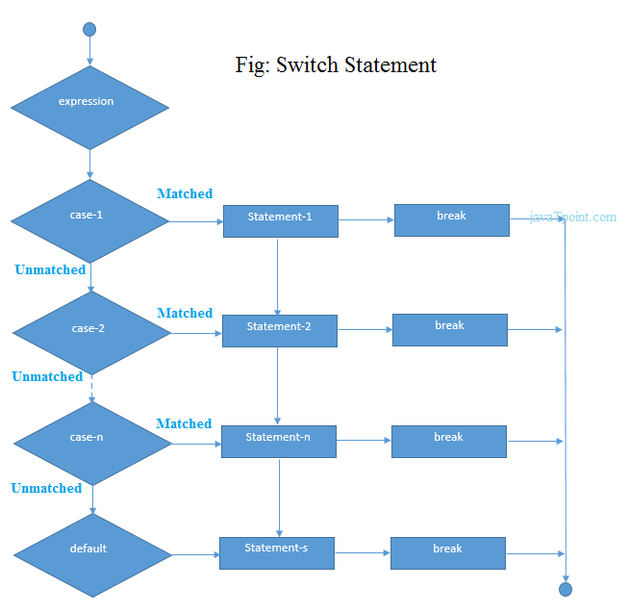
C Programming
Flowchart for Switch Statement:-

Slide 42
C Programming
Program for Switch Statement:- #include<stdio.h>
void main(){
int number=0;
printf("enter a number:");
scanf("%d",&number);
switch(number){ case 10: printf("number is equals to 10");
break;
case 50: printf("number is equal to 50");
break;
case 100: printf("number is equal to 100");
break;
default: printf("number is not equal to 10, 50 or 100");
} }
Output:- Enter a number:4
Number is not equal to10,50 or 100

Slide 43
C Programming
Loops In C:- The loops in C language are used to execute a block of code or a part of the program several times.
Advantage of loops in C:-
1) It saves code.
2) It helps to traverse the elements of array (which is covered in next pages).

Slide 44
C Programming
Types of Loops In C:- There are three types of loops in C language that is given below:
do while
while
for

Slide 45
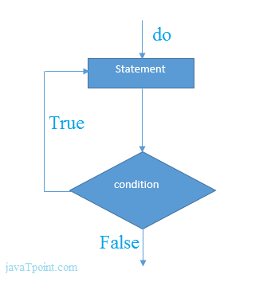
C Programming
do-while loop:- It iterates the code until condition is false. Here, condition is given after the code. So at least once, code is executed whether condition is true or false.
The syntax of do-while loop in c language is given below:
do{
//code to be executed
}while(condition);

Slide 46
C Programming
do-while loop:- #include<stdio.h>
int main(){
int i=1;
do{
printf("%d ",i);
i++;
}while(i<=10);
return 0;
}
O/p:- 1 2 3 4 5 6 7 8 9 10

Slide 47
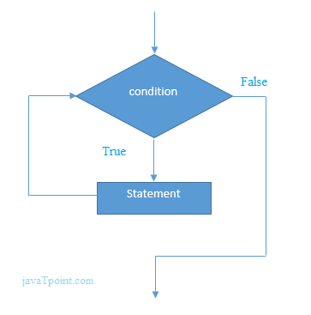
C Programming
while loop:- The while loop in C language is used to iterate the part of program or statements many times. The C language while loop should be used if number of iteration is uncertain or unknown.
Syntax of while loop in C language:-
The syntax of while loop in c language is given below:
while(condition){
//code to be executed
}

Slide 48
C Programming
while loop:- #include<stdio.h>
int main(){
int i=1;
while(i<=10){
printf("%d \n",i);
i++;
}
return 0;
}
O/p:- 1 2 3 4 5 6 7 8 9 10

Slide 49
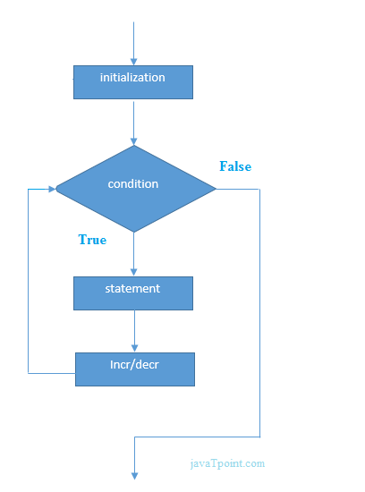
C Programming
for loop:-The for loop in C language is also used to iterate the statement or a part of the program several times, like while and do-while loop.
Syntax of for loop in C:-
The syntax of for loop in c language is given below:
for(initialization;condition;incr/decr){
//code to be executed
}

Slide 50
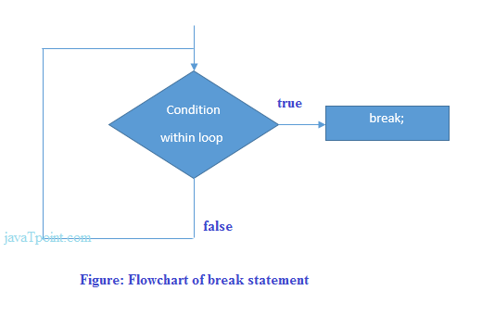
C Programming
Break Statement:-The break statement in C language is used to break the execution of loop (while, do while and for) and switch case.
In case of inner loops, it terminates the control of inner loop only.
Syntax:-
jump-statement;
break;

Slide 51
C Programming
Continue Statement:- The continue statement in C language is used to continue the execution of loop (while, do while and for). It is used with if condition within the loop.
Syntax:-
jump-statement;
continue;

Slide 52
C Programming
Example of Continue Statement:- #include<stdio.h>
int main(){ int i=1;//initializing a local variable
//starting a loop from 1 to 10
for(i=1;i<=10;i++){
if(i==5){//if value of i is equal to 5, it will continue the loop
continue;
} printf("%d \n",i);
}//end of for loop
return 0; }
Output:- 1 2 3 4 5 6 7 8 9 10

Slide 53
C Programming
Type Casting:- Type casting allows us to convert one data type into other. In C language, we use cast operator for type casting which is denoted by (type).
Syntax:
(type)value;
Without Type Casting:
int f= 9/4;
printf("f : %d\n", f );//Output: 2
With Type Casting:
float f=(float) 9/4;
printf("f : %f\n", f );//Output: 2.250000

Slide 54
C Programming
Function:- The function in C language is also known as procedure or subroutine in other programming languages.
Advantages:-
1. Code reusability
2. Code Optimization

Slide 55
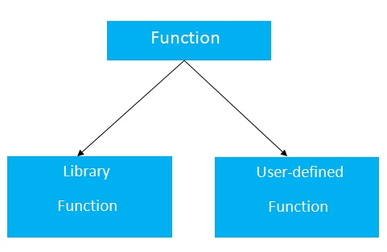
C Programming
Types of Function:-
1. Library Function:- printf(),scanf(),gets(),puts(),ceil(),floor() etc
2. User Define Function:- are the functions which are created by the C programmer, so that he/she can use it many times. It reduces complexity of a big program and optimizes the code.

Slide 56
C Programming
Declaration of a function:-
The syntax of creating function in c language is given below:
return_type function_name(data_type parameter...){
//code to be executed
}

Slide 57
C Programming
Parameters in C function:-
A c function may have 0 or more parameters. You can have any type of parameter in C program such as int, float, char etc. The parameters are also known as formal arguments.
Example of a function that has 0 parameter:
void hello(){
printf("hello c");
}

Slide 58
C Programming
Example of a function that has 1 parameter:-
int cube(int n){
return n*n*n;
}
Example of a function that has 2 parameters:-
int add(int a, int b){
return a+b;
}

Slide 59
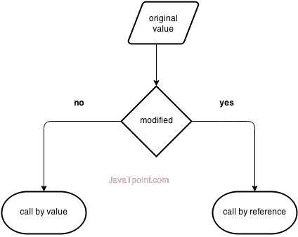
C Programming
Call By Value and Call By reference in C:- There are two ways to pass value or data to function in C language: call by value and call by reference. Original value is not modified in call by value but it is modified in call by reference.

Slide 60
C Programming
Call By Value in C:- In call by value, original value is not modified.
In call by value, value being passed to the function is locally stored by the function parameter in stack memory location. If you change the value of function parameter, it is changed for the current function only. It will not change the value of variable inside the caller method such as main().

Slide 61
C Programming
Example of Call By Value in C:- #include<stdio.h>
void change(int num) {
printf("Before adding value inside function num=%d \n",num);
num=num+100;
printf("After adding value inside function num=%d \n", num); }
int main() {
int x=100;
printf("Before function call x=%d \n", x);
change(x);//passing value in function
printf("After function call x=%d \n", x);
return 0; }
Output:- Before Function call x=100
Before adding function value inside function num=200
After Function Call x=100

Slide 62
C Programming
Call By Reference in C:- In call by reference, original value is modified because we pass reference (address).
Here, address of the value is passed in the function, so actual and formal arguments shares the same address space. Hence, value changed inside the function, is reflected inside as well as outside the function.

Slide 63
C Programming
Example of Call By Reference in C:- #include<stdio.h>
void change(int *num) {
printf("Before adding value inside function num=%d \n",*num);
(*num) += 100;
printf("After adding value inside function num=%d \n", *num);
} int main() { int x=100;
printf("Before function call x=%d \n", x);
change(&x);//passing reference in function
printf("After function call x=%d \n", x);
return 0;}
Output:- Before Function call x=100
Before adding function value inside function num=100
After Adding function value inside function num=200
After Function Call x=200

Slide 64
C Programming
Recursion in C:- When function is called within the same function, it is known as recursion in C. The function which calls the same function, is known as recursive function.
A function that calls itself, and doesn't perform any task after function call, is know as tail recursion. In tail recursion, we generally call the same function with return statement. An example of tail recursion is given below.
Let's see a simple example of recursion.
recursionfunction(){
recursionfunction();//calling self function
}

Slide 65
C Programming
Example of Tail Recursion in C:- #include<stdio.h>
int factorial (int n)
{ if ( n < 0)
return -1; /*Wrong value*/
if (n == 0)
return 1; /*Terminating condition*/
return (n * factorial (n -1)); }
int main(){ int fact=0;
fact=factorial(5);
printf("\n factorial of 5 is %d",fact);
return 0; }
Output:- factorial of 5 is 120

Slide 66
C Programming
Storage Class in C:- Storage classes are used to define scope and life time of a variable. There are four storage classes in C programming.
auto
extern
static
register

Slide 67
C Programming
Storage Class in C:-
Storage Classes | Storage Place | Default Value | Scope | Life-time
auto | RAM | Garbage Value | Local | Within function
extern | RAM | Zero | Global | Till the end of main program, May be declared anywhere in the program
static | RAM | Zero | Local | Till the end of main program, Retains value between multiple functions call
register | Register | Garbage Value | Local | Within function

Slide 68
C Programming
Storage Class in C:-
auto:- The auto keyword is applied to all local variables automatically. It is the default storage class that’s why this is known as automatic variable.
Syntax:- #include<stdio.h>
int main(){
int a=10;
auto int b=10;
printf(“%d %d”,&a,&b);
return 0;
}
Output:- 10 10

Slide 69
C Programming
Storage Class in C:-
2. register:- The register variable allocates memory in register than RAM. Its size is same of register size. It has a faster access than other variables.
register int counter=0;

Slide 70
C Programming
Storage Class in C:-
3. static:- The static variable is initialized only once and exists till the end of the program. It retains its value between multiple functions call.
The static variable has the default value 0 which is provided by compiler.

Slide 71
C Programming
Storage Class in C:-
3. static:- #include<stdio.h>
int func(){
static int i=0; //static variable
int j=0; // local variable
printf()
}

Slide 72
C Programming
Storage Class in C:-
3. static:- The static variable is initialized only once and exists till the end of the program. It retains its value between multiple functions call.
The static variable has the default value 0 which is provided by compiler.

Slide 73
C Programming
Storage Class in C:-
4. extern:- The extern variable is visible to all the programs. It is used if two or more files are sharing same variable or function.
extern int counter=0;

Slide 74

C Programming
C Pointers:-
The pointer in C language is a variable, it is also known as locator or indicator that points to an address of a value.

Slide 75
C Programming
Advantages of C Pointers:-
1) Pointer reduces the code and improves the performance, it is used to retrieving strings, trees etc. and used with arrays, structures and functions.
2) We can return multiple values from function using pointer.
3) It makes you able to access any memory location in the computer's memory.

Slide 76
C Programming
Usage of C Pointers:-
1) Dynamic Memory Allocation
2) Array, Function and Structures

Slide 77
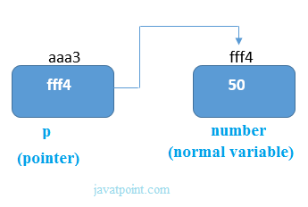
C Programming
Declarations of C Pointers:-
The pointer in c language can be declared using * (asterisk symbol).
int *a;//pointer to int
char *c;//pointer to char

Slide 78
C Programming
Null Pointers:- A pointer that is not assigned any value but NULL is known as NULL pointer. If you don't have any address to be specified in the pointer at the time of declaration, you can assign NULL value. It will a better approach.
int *p=null
In most the libraries, the value of pointer is 0 (zero).

Slide 79

C Programming
C Pointer to Pointers:- In C pointer to pointer concept, a pointer refers to the address of another pointer.
In c language, a pointer can point to the address of another pointer which points to the address of a value. Let's understand it by the diagram given below:
Let's see the syntax of pointer to pointer.
int **p2;

Slide 80
C Programming
Array:- Array in C language is a collection or group of elements (data). All the elements of c array are homogeneous (similar). It has contiguous memory location.
Advantages of Array:-
1. Code optimization
2. Easy to traverse data
3. Easy to sort data
4. Fixed Access
Disadvantages:-
1. Fixed Size

Slide 81
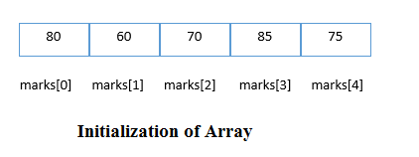
C Programming
Declaration of Array:- We can declare an array in the c language in the following way.
data_type array_name[array_size];
Now, let us see the example to declare array.
int marks[5];

Slide 82
C Programming
C Array Example:- #include<stdio.h>
int main(){ int i=0;
int marks[5];//declaration of array
marks[0]=80;//initialization of array
marks[1]=60;
marks[2]=70;
marks[3]=85;
marks[4]=75;
//traversal of array
for(i=0;i<5;i++){
printf("%d ",marks[i]);
}//end of for loop return 0; }
O/p:- 60 70 75 80 85

Slide 83
C Programming
Two Dimensional Array:- We can declare an array in the c language in the following way.
data_type array_name[size1][size2];
A simple example to declare two dimensional array is given below.
int twodimen[4][3];

Slide 84
C Programming
Two Dimensional Array:- The two dimensional array in C language is represented in the form of rows and columns, also known as matrix. It is also known as array of arrays or list of arrays.
The two dimensional, three dimensional or other dimensional arrays are also known as multidimensional arrays.
data_type array_name[size1][size2];

Slide 85
C Programming
Two Dimensional Array:- We can declare an array in the c language in the following way.
data_type array_name[size1][size2];
A simple example to declare two dimensional array is given below.
int twodimen[4][3];

Slide 86
C Programming
Passing Array To functions:- To reuse the array operation, we can create functions that receives array as argument. To pass array in function, we need to write the array name only in the function call.
functionname(arrayname);//passing array
First way:
return_type function(type arrayname[])
Second way:
return_type function(type arrayname[SIZE])
Third way:
return_type function(type *arrayname)

Slide 87
C Programming
C String:- String in C language is an array of characters that is terminated by \0 (null character).
There are two ways to declare string in c language.
By char array
By string literal

Slide 88
C Programming
C gets() and puts() Function:- The gets() function reads string from user and puts() function prints the string. Both functions are defined in <stdio.h> header file.
#include<stdio.h>
#include <string.h>
int main(){
char name[50];
printf("Enter your name: ");
gets(name); //reads string from user
printf("Your name is: ");
puts(name); //displays string
return 0; }
Output:- Enter Your Name
Your Name is Sumon Karmakar

Slide 89
C Programming
C String Function:-
strlen() function:- The strlen() function returns the length of the given string. It doesn't count null character '\0’.
#include<stdio.h>
#include <string.h>
int main(){
char ch[20]={'j', 'a', 'v', 'a', 't', 'p', 'o', 'i', 'n', 't', '\0'};
printf("Length of string is: %d",strlen(ch));
return 0;
}
Output:- Length of the String is 10

Slide 90
C Programming
C String Function:-
strcat() function:- The strcat(first_string, second_string) function concatenates two strings and result is returned to first_string.
#include<stdio.h>
#include <string.h>
int main(){
char ch[10]={'h', 'e', 'l', 'l', 'o', '\0'};
char ch2[10]={'c', '\0'};
strcat(ch,ch2);
printf("Value of first string is: %s",ch);
return 0;
}
Output:- Length of the String is 10

Slide 91
C Programming
C String Function:-
strcmp() function:- The strcmp(first_string, second_string) function compares two string and returns 0 if both strings are equal.

Slide 92
C Programming
C String Function:-
strlwr() function:- The strlwr(string) function returns string characters in lowercase.
#include<stdio.h>
#include <string.h>
int main(){
char str[20];
printf("Enter string: ");
gets(str);//reads string from console
printf("String is: %s",str);
printf("\nLower String is: %s",strlwr(str));
return 0;
}
O/P:- Enter string: JAVATpoint
String is: JAVATpoint
Lower String is: javatpoint

Slide 93
C Programming
C String Function:-
strupr() function:- The strupr(string) function returns string characters in uppercase. Let's see a simple example of strupr() function.
#include<stdio.h>
#include <string.h>
int main(){ char str[20];
printf("Enter string: ");
gets(str);//reads string from console
printf("String is: %s",str);
printf("\nUpper String is: %s",strupr(str));
return 0;
}
O/p:- Enter String:- Javatpoint
String is Javatpoint
Reverse String is tniopavaJ

Slide 94
C Programming
C String Function:-
strstr() function:- The strstr() function returns pointer to the first occurrence of the matched string in the given string. It is used to return substring from first match till the last character.
Syntax:
char *strstr(const char *string, const char *match)

Slide 95
C Programming
C File Handling:-
File Handling in c language is used to open, read, write, search or close file. It is used for permanent storage.
Advantages of File Handling:- It will contain the data even after program exit. Normally we use variable or array to store data, but data is lost after program exit. Variables and arrays are non-permanent storage medium whereas file is permanent storage medium.

Slide 96
C Programming
C File Handling:-
Functions for file handling:-
No. | Function | Description
1 | fopen() | opens new or existing file
2 | fprintf() | write data into file
3 | fscanf() | reads data from file
4 | fputc() | writes a character into file
5 | fgetc() | reads a character from file
6 | fclose() | closes the file
7 | fseek() | sets the file pointer to given position
8 | fputw() | writes an integer to file
9 | fgetw() | reads an integer from file
10 | ftell() | returns current position
11 | rewind() | sets the file pointer to the beginning of the file

Slide 97
C Programming
C File Handling:-
Opening a File:- The fopen() function is used to open a file. The syntax of fopen() function is given below:
FILE *fopen( const char * filename, const char * mode );

Slide 98
C Programming
C File Handling:-
Mode of Opening a File:-
Mode | Description
r | opens a text file in read mode
w | opens a text file in write mode
a | opens a text file in append mode
r+ | opens a text file in read and write mode
w+ | opens a text file in read and write mode
a+ | opens a text file in read and write mode
rb | opens a binary file in read mode

Slide 99
C Programming
C File Handling:-
fprintf() and fscanf():- The fprintf() function is used to write set of characters into file. It sends formatted output to a stream.
Syntax:
int fprintf(FILE *stream, const char *format [, argument, ...])
Example:
#include <stdio.h>
main(){
FILE *fp;
fp = fopen("file.txt", "w");//opening file
fprintf(fp, "Hello file by fprintf...\n");//writing data into file
fclose(fp);//closing file
}

Slide 100
C Programming
C File Handling:-
fprintf() and fscanf():- The fscanf() function is used to read set of characters from file. It reads a word from the file and returns EOF at the end of file.
Syntax:- int fscanf(FILE *stream, const char *format [, argument, ...])
Example:
#include <stdio.h>
main(){ FILE *fp;
char buff[255];//creating char array to store data of file
fp = fopen("file.txt", "r");
while(fscanf(fp, "%s", buff)!=EOF){
printf("%s ", buff ); }
fclose(fp); }

Slide 101
C Programming
C File Handling:-
fputc() and fgetc():- The fputc() function is used to write a single character into file. It outputs a character to a stream.
Syntax:
int fputc(int c, FILE *stream)
#include <stdio.h>
main(){
FILE *fp;
fp = fopen("file1.txt", "w");//opening file
fputc('a',fp);//writing single character into file
fclose(fp);//closing file
}
O/p:- a

Slide 102
C Programming
C File Handling:-
fputc() and fgetc():- The fgetc() function returns a single character from the file. It gets a character from the stream. It returns EOF at the end of file.

Slide 103
Thank You

